Slide 1
FOREIGN POLICY OF PAKISTAN
A
INTRODUCTION TO FOREIGN POLICY
B
FOREIGN POLICY DETERMINANTS, PRINCIPLES & PHASES OR SHIFTS
C
PAKISTAN RELATIONS WITH NEIGHBORING STATES
1947 to till Present
D
CHANLLENGES TO F.P
TODAY

Slide 2
Definition of Foreign Policy
A
INTRODUCTION TO FOREIGN POLICY
The state involve themselves in international relations with systematic as well as defined principles. The process, the dealing or the interaction of a state in world system is called foreign policy.

Slide 3
Lord Palmer Stone
“In International relations there are no permanent friend no permanent enemy, but the national interest remains permanent”.

Slide 4
F.P of Pakistan: a triangle
China (the enemy of my enemy is my friend)
U.S serving Washington's Interests)
India (Countering the adversaries)

Slide 5
5. Economic Compulsions
1. Ideological Obligations
2. Historical Legacy
DETERMINANTS OF F.P
4. India Threat
3. Geographical Location
B

Slide 6
1. Peaceful Co-Existence
2. Non-Alignment
3. United Nations Charter
5. Islamic World
6. International and Regional Cooperation
4. Nuclear Non-Proliferation
FOREIGN POLICY PRINCIPLES
B
Notes:
1. respects the liberty, freedom and sovereignty of others, . Pakistan doesn’t interfere in others internal affairs of other states
2. In 1954 and 1955 Pakistan had signed SEATS and CENTO but in 1979, NAM set up, April 24, 1955, PAK joined Sept 30, 1979
4. suggested for the De-Weaponisation of South Asia
5. Member OIC
6. Pakistan is the active member of UN, NAM, OIC, SAARC, and SCO

Slide 7
B
Phases of Foreign Policy of Pakistan
Era of Neutrality (1947-53)
Era of Alliances (1954-62)
Third and Fourth Phase
Era of Bilateralism (1963-78)
Era of Non-Alignment (1979-89)
Fifth and sixth Phase
Era of Post-Cold-War (1990-2001)
Era of Global Antiterrorism (2001- till present)
FOREIGN POLICY PHASES OR SHIFTS

Slide 8

Era of Neutrality (1947-53)
Causes of Neutrality:
Cold War & Bipolar System
Kashmir, Water Issue/Initial Problems
Afghanistan (Durand Line, Pakhtunistan) not recognized Pak
Muslim state under colonial Powers
Pakistan had four options:
To remain Neutral
To rely on Muslim Countries
To Join Soviet Block
To Join Western alliances
Final Option:
1. Forth option
No Pacts/Agreement of War

Slide 9
Era of Alliances (1954-62)
Joined SEATO, CENTO
Signed Defence Pact
Objective to join alliances
Economic Assistance
Modernization of Army
Hope to restore Kashmir issue
Security
Reconsideration of Alliances
US don’t supported-Kashmir
U-2 Incident https://www.youtube.com/watch?v=NPH9ZWMYImg
Suez Crisis
Block Politics
Notes:
2. In 1959 US signed defense pact with Pakistan to protect Pak from Communist attack
Pak termed US Protégé, H.S Shorwardi termed Pak, “Most Allied Ally.”
Reconsider
2. U-2 1960
a. Sino-India war 1962
3. Arab were not happy with Pak as CENTO member-Israel, Suez Canal

Slide 10
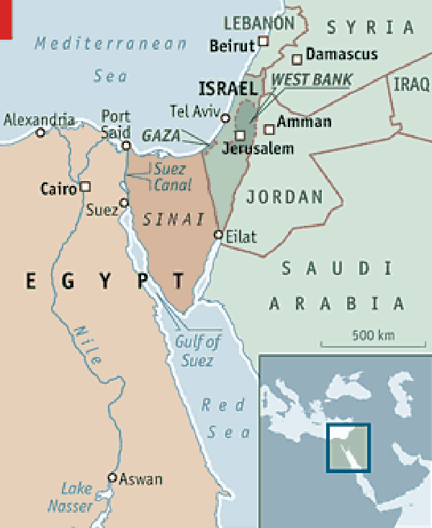
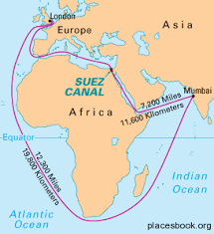
Suez Canal Crisis
Notes:
In 1858 - 1869 Canal Setup, first ship passed – S.S Dido
Aswan Dam to be built by UK and France
25 OCT, 1956 Israel attacked on Western Part of Suez Canal
March 1957 the Canal reopened again by UN

Slide 11
Era of Bilateralism (1963-78)
Bilateral Relations with China
Tashkent Agreement
1965 war, supported Arab-Israel War
Formed RCD
Withdrew form Alliances
Setting Up of O.I.C
1971 war, Second O.I. C Submit
Agreement with one country, Relations with Third World, Socialist Countries.
Notes:
As support against India
Pak reorientation with US-suspended military support to both India, Pak
Turned to Third World & Middle East countries
RCD 1964
Détente 1971
Withdrew from Commonwealth in 1972

Slide 12
Era of Non-Alignment (1979-89)
CENTO ended in 1979
Joined NAM
Russian invasion of Afghanistan
Objective of this era
Relations with China
Close relations with US
Eco-political ties with Muslims
Policy of Non-alignment in world affairs
Security
Nuclear Boost
No Bloc Politics,
Notes:
After withdrawal from CENTO Pak could join NAM, at Havana submit Sept, 1979.
US gave 3.2 (1982) & 4.02 (1986) billion dollars aid against Russia.

Slide 13
Era of Post-Cold-War (1990-2001)
Dismantling of Warsaw Pact/Soviet Union
Collapse of USSR
Tested Nuke at Chagai
Nuclear Proliferation
Impacts on Pakistan
Pressurized to rollback Nuke
Terrorist Tag
Silenced on Kashmir
End of Bipolar System, Started Unipolar-Monopoly of US,

Slide 14
Era of Global Antiterrorism (2001- till present)
9/11- War on Terror
March-April 2003 Iraq invasion
Operation Zarb-e-Azb-2014
Pakistan had four option
To remain Neutral
To support US
To discard Taliban
To fight War on Terror
War on Terror, Taliban Talks, Withdrawal of Forces
Notes:
US Demand:
Disown Taliban, Seal borders with Afghanistan, cut fuel supply to Taliban and block Al-Qaeda’s movements.
Agreement for Bringing Peace to Afghanistan, Feb 29, 2020
The withdrawal of all American and NATO troops, a Taliban pledge to prevent al-Qaeda, and talks between Taliban - the Afghan government.

Slide 15
Relations With Neighbouring States
C
PAKISTAN RELATIONS WITH NEIGHBORING STATES
Afghanistan, China, India, Iran

Slide 16
Afghanistan
Durand Line, Russian War,
War on Terrorism

Slide 17
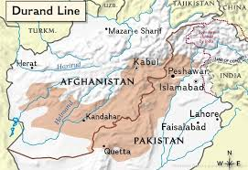

Slide 18
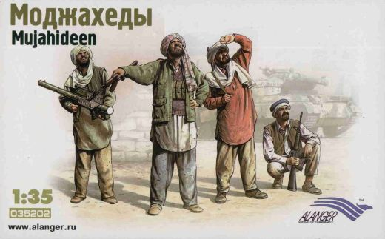

Slide 19
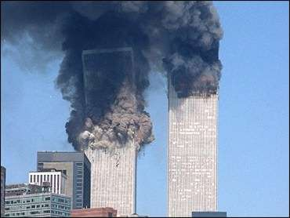

Slide 20
China
1963 accord, K2 Highway,
Nuclear, CPEC

Slide 21
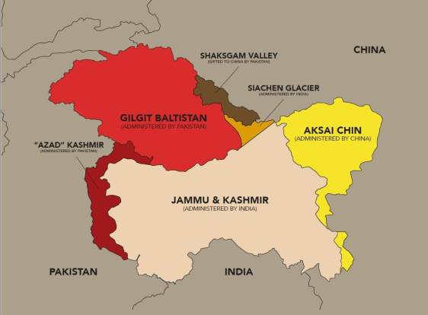

Slide 22
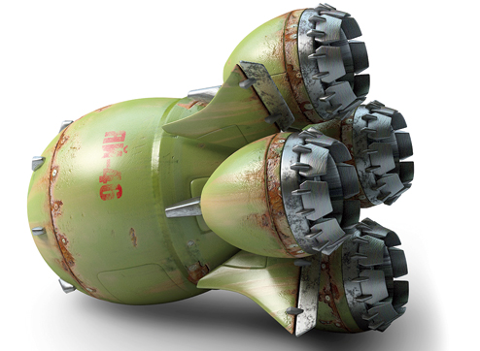
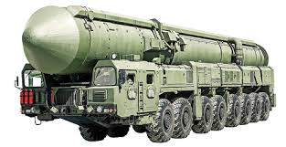

Slide 23
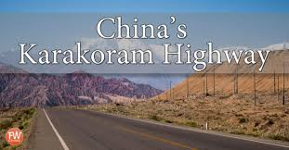


Slide 24
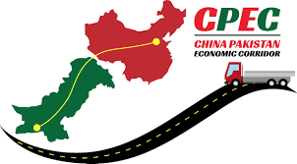

Slide 25
India
1965, 1971 Wars,
Nuclear race, War on Terrorism

Slide 26
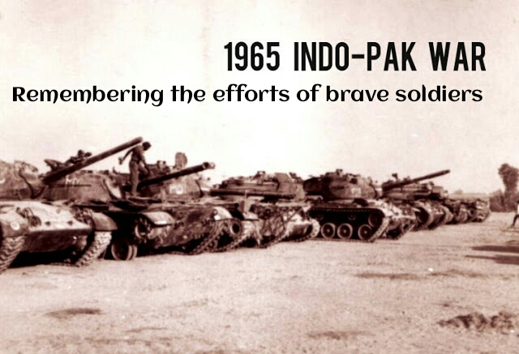

Slide 27
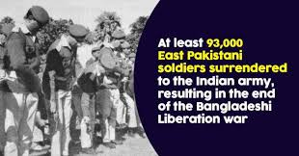

Slide 28
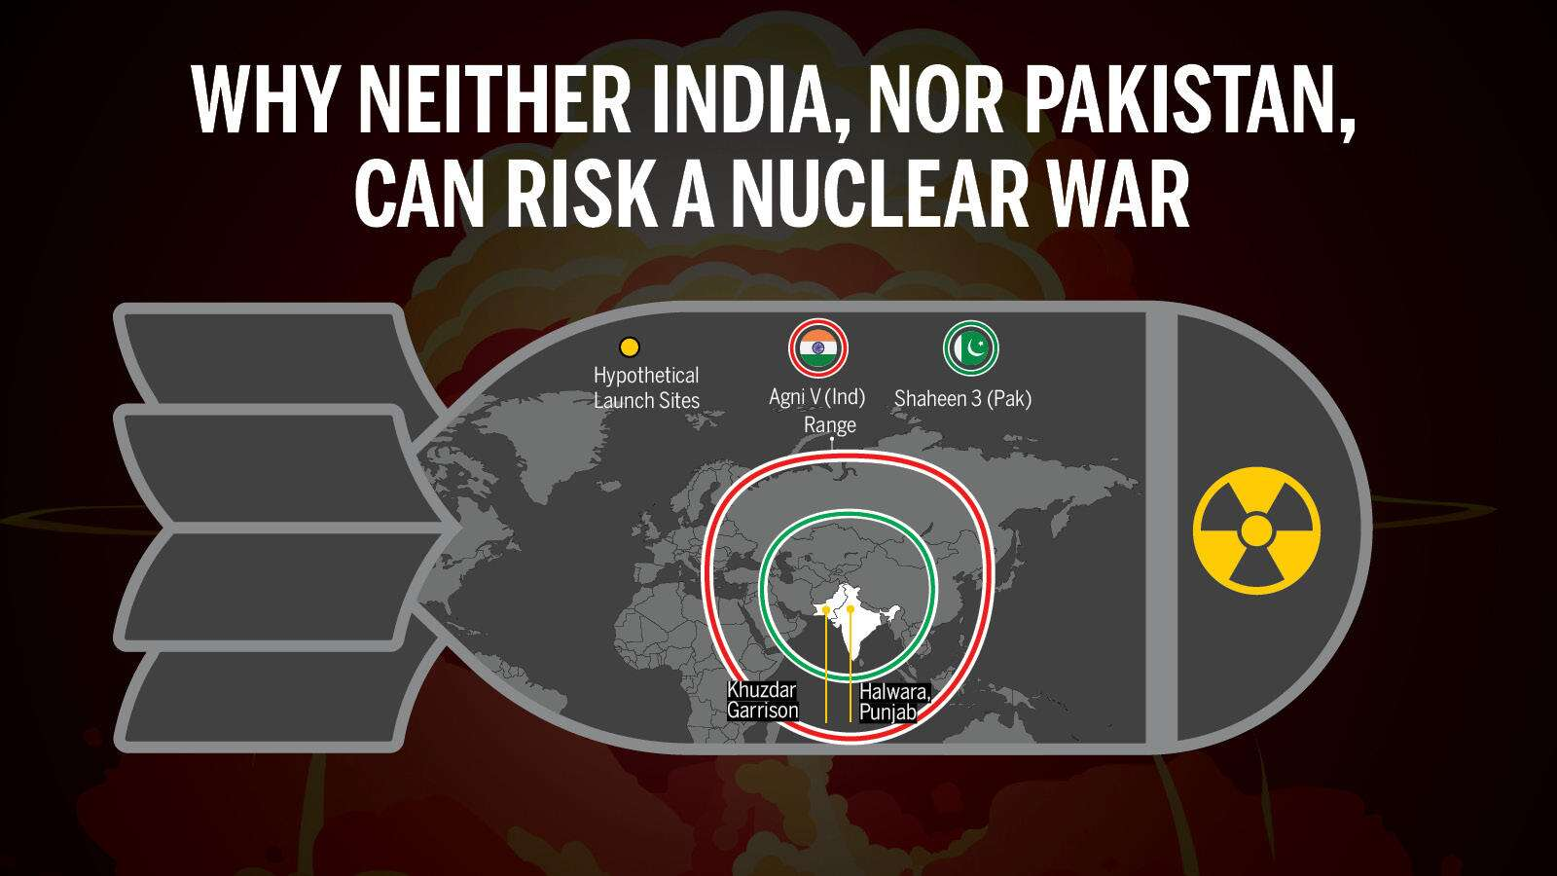

Slide 29
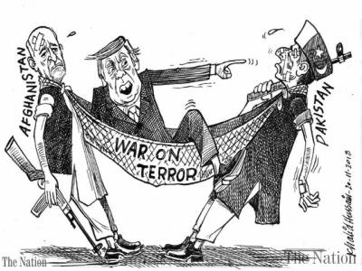

Slide 30
Iran
Recognized Pak, Nuclear Program,
Revolutionary guards

Slide 31
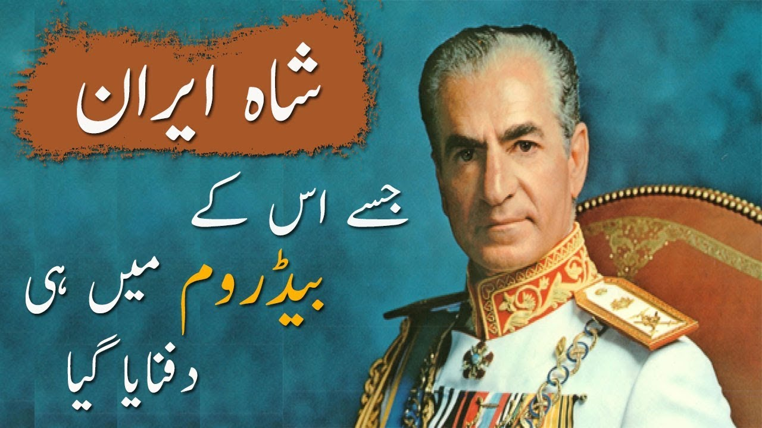

Slide 32
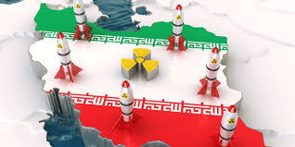

Slide 33
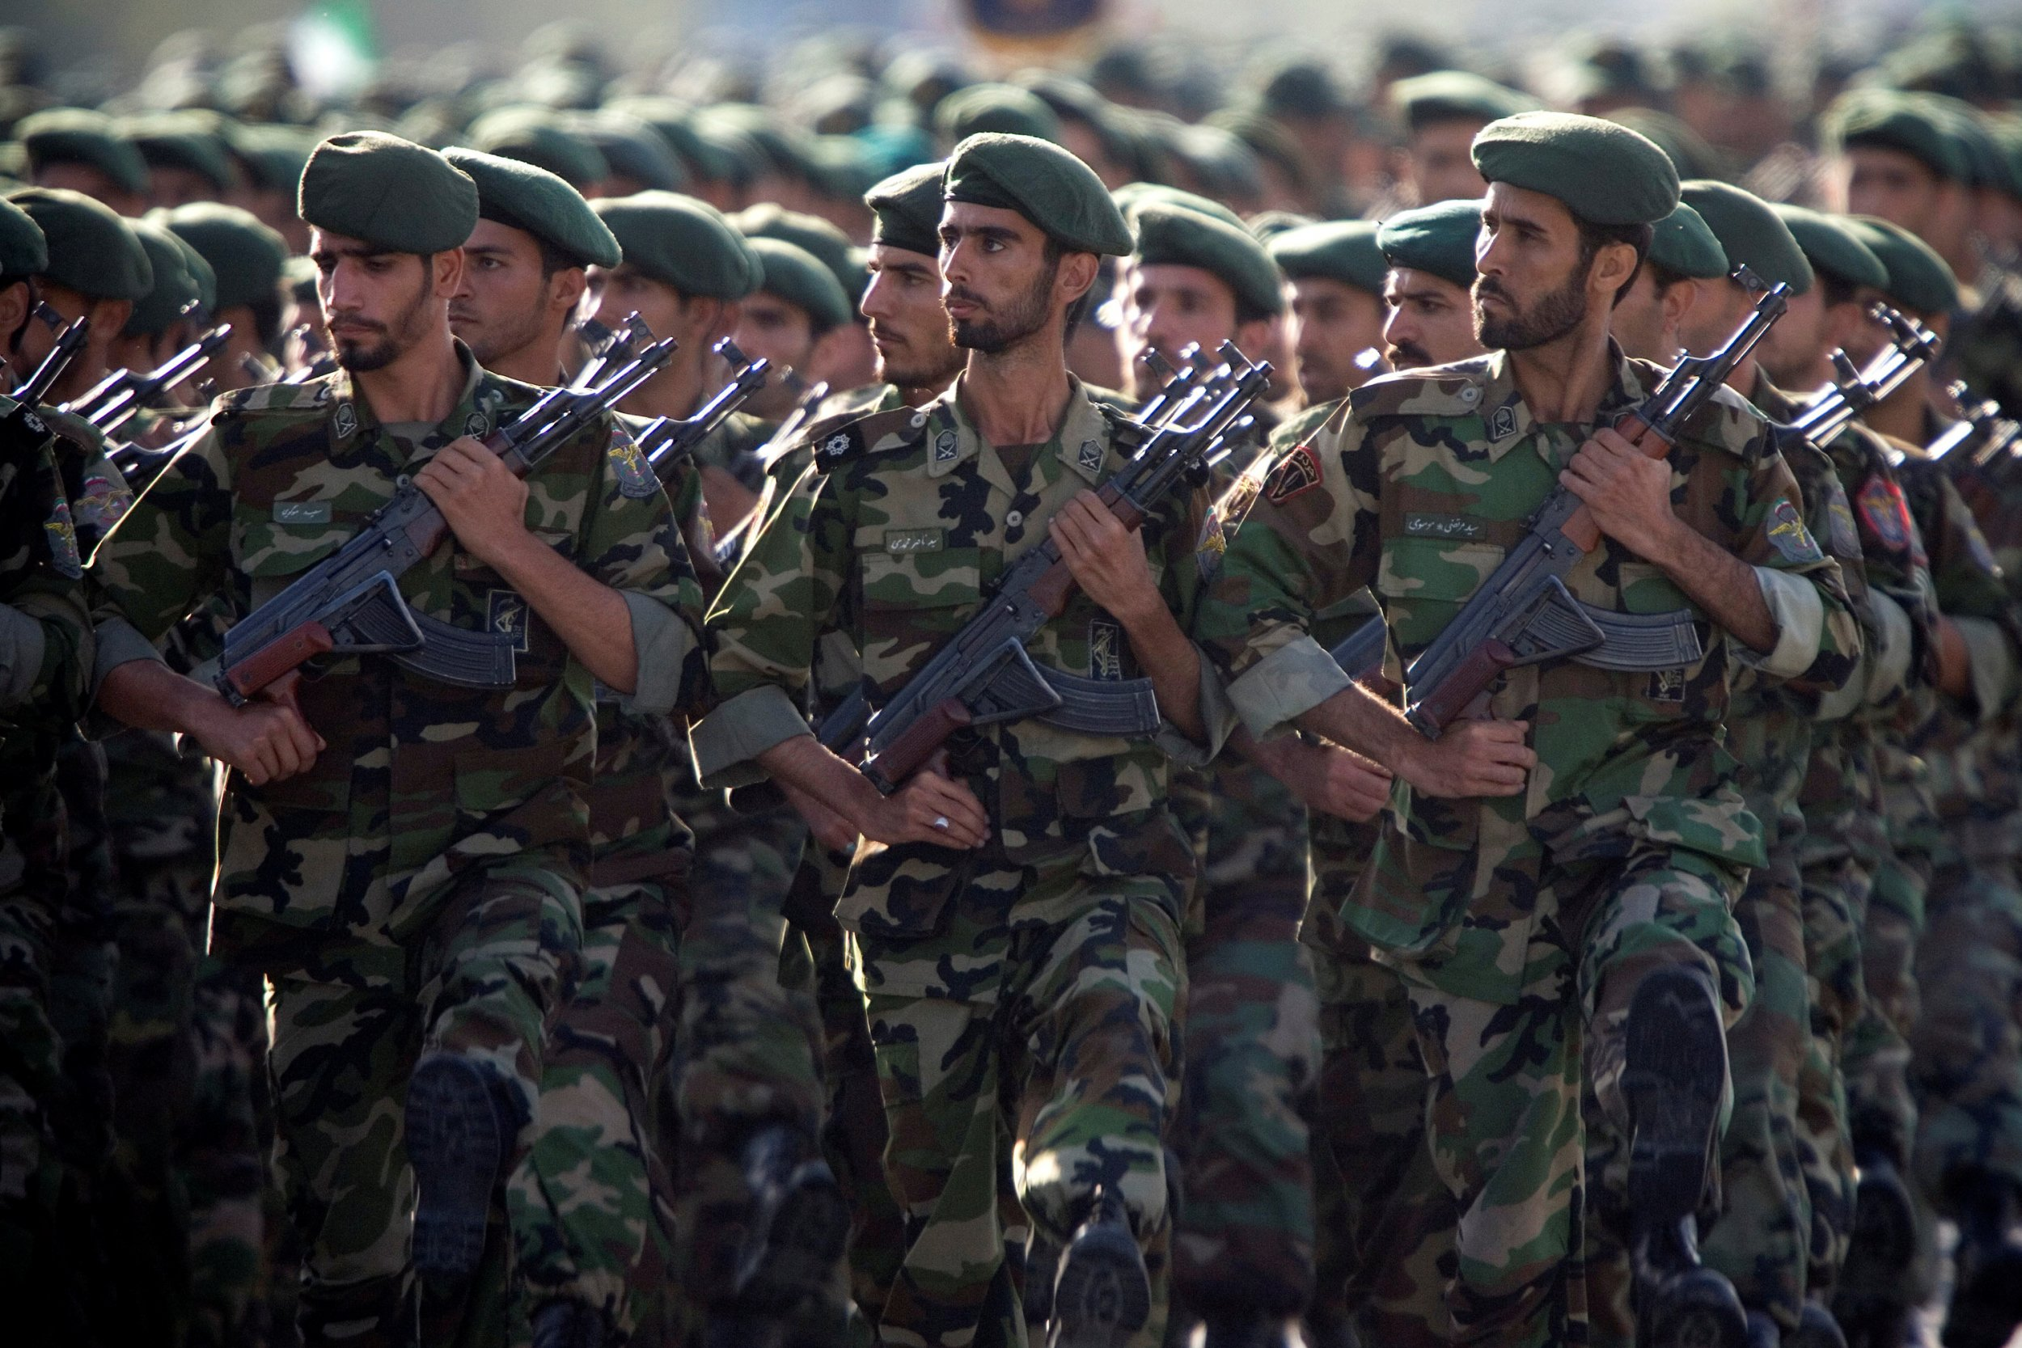
Iran Revolutionary Guards

Slide 34
Revocation of Kashmir
Abhednadan
CPEC
Arab Israel Conflict
Humanitarian Crisis Post Afghan War
Unipolar Power Shift (China Vs. US)
C
CHANLLENGES TO F.P
TODAY

